Slide 1
Best practices for pager rotation duties
Ensuring Effective On-Call Management
Chynna Lee -Devops

Slide 2
Brief overview
Pager rotation duties involve assigning team members to be on call for handling any incidents or issues that arise in the system to respond to alerts and maintain the reliability and performance of the application.

Slide 3

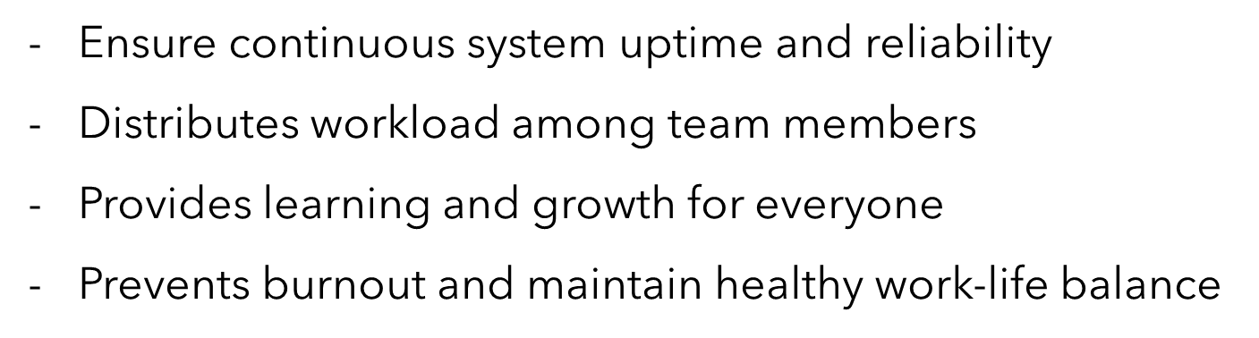
Importance of pager rotation in devops:

Slide 4

Establishing clear on call policies
Define on-call expectations and responsibilities
Set clear escalation paths and procedures
Document runbocks and playbooks for common incidents
Ensure all team members are trained and aware of policies

Slide 5
Creating a fair rotation schedule
Rotate on-call duties equitably among team members
Consider time zones and personal preferences
Use automated scheduling tools to manage rotations
Allow for flexibility and swaps when necessary

Slide 6
Tools and technologies for on-call management
Monitoring and alerting tools (Prometheus, Grafana)
Incident management platforms (PagerDuty, OpsGenie)
Communication tools (Slack, Microsoft Teams)
Automated incident response and runbook automation tools

Slide 7
Incident response and escalation procedures
Immediate incident triage and assessment
Clear criteria for escalating issues
Regular incident review and post-mortem analysis
Continuous improvement of incident response processes

Slide 8
Ensuring work life balance
Encourage taking breaks and vacations
Limit the number of consecutive on-call shifts
Provide mental health support and resources
Foster a supportive team culture

Slide 9

Continuous improvement and feedback
Regularly review and update on-call policies and procedures
Collect feedback from on-call team members
Analyze data to identify patterns and areas for improvement
Implement changes based on feedback and data analysis

Slide 10
references
PagerDuty. (n.d.). Call rotations & schedules. Retrieved July 13, 2024, from https://www.pagerduty.com/resources/learn/call-rotations-schedules/#toc-0

